Slide 1
Mobile Payment
ADM 3378
Jenny Guan
Stephanie Morrison
Ben Norris
Justyn Rennicks
Yawen Yuan
Yi Yuan

Slide 2
Agenda
Introduction
Technologies
Business Models
Privacy and Legal Issues
Applications and Solutions
AliPay
Advantages and Disadvantages
ApplePay
Advantages and Disadvantages
Conclusion

Slide 3
Mobile Payment
The use of wireless handheld devices such as cellular phones to conduct commercial transactions. Mobile transactions continues to grow, and the term includes the purchase and sale of a wide range of goods and services, banking, bill payment, information delivery and so on.

Slide 4
Technologies
USSD (Unstructured Supplementary Service Data)
4% usage rate
Used mostly in developing countries
Pros: Easy to use, easy to implement
Cons: Plain text (low security), missing security layers
BLE (Bluetooth Low Energy)
1Mbit/sec transfer rate, 10mW max power, 50m range
40% usage rate
Pros: Most smartphones enabled, easy, low power, support
Cons: Security (range), no backward compatibility
Lerner, T. (2013). Mobile Payment. Springer Fachmedian Wiesbaden (pp. 39-60)

Slide 5
Technologies (cont.)
SMS (Short Message Service)
51% usage rate
Pros: On nearly all mobile devices worldwide, Easy
Cons: Expensive, asynchronous, lack of encryption
WAP (Wireless Application Protocol)
38% usage rate
Pros: Better security than SMS / USSD / BLE, familiar (LTE), synchronous
Cons: Expensive (pay for data)
QR codes
16% usage rate
Pros: easy to use, convenient, good for adding information
Cons: Only available on smartphones, security risks
Lerner, T. (2013). Mobile Payment. Springer Fachmedian Wiesbaden (pp. 39-60)

Slide 6
Technologies (cont.)
NFC (Apple Pay)
Uses magnetic fields to send and receive information
8% usage rate (2013) – more since iPhone 6
Pros: ~ 15-second processing, convenient, secure, compatible with RFID
Cons: Needs additional hardware (SD/SIM)
Sound Wave Payment (Alipay Wallet)
Uses ultrasonic sound waves, which can be embedded in sound clips
No usage statistics, but implemented in Alipay Wallet, so widely used
Pros: No extra hardware needed for the consumer, low cost for retailer, easy
Cons: Signal interference (environment-dependent), security
Lerner, T. (2013). Mobile Payment. Springer Fachmedian Wiesbaden (pp. 39-60)
Near Field Communication. Retrieved Nov. 11, 2014 from http://www.nearfieldcommunication.org
Naratte: Mobile payment using sound waves. Retrieved Nov. 11, 2014 from
http://www.cnet.com/news/naratte-mobile-payments-using-sound-waves/

Slide 7
Business Models and Strategy
Four main business models
MNO Driven or Operator Centric Model
Bank Centric Model
Independent or Peer-to-Peer Model
Collaborative Model

Slide 8
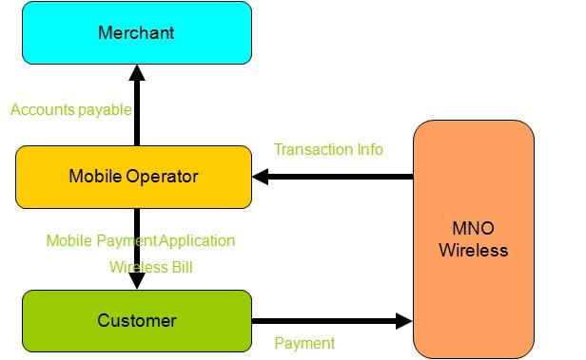
MNO Driven Model
Mobile network providers (MNOs) design and distribute their own mobile applications
Revenue generated by:
charging to regular phone bill
prepaying for service
Sources: http://kunalroychoudhury.blogspot.ca/2012/08/mobile-payment-models-stake-holders.html and http://www.smartcardalliance.org/resources/lib/Mobile_Payment_Business_Model_Research_Report.pdf

Slide 9
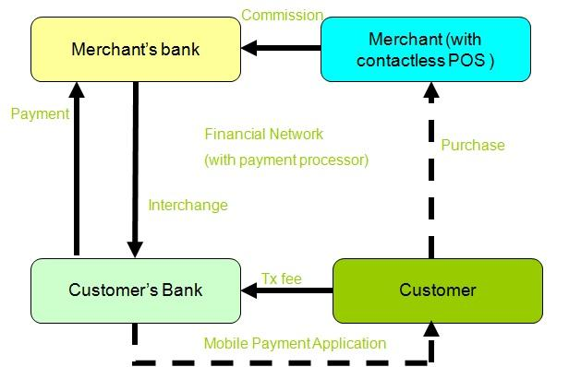
Bank Driven Model
Takes existing four corners model and puts it into a mobile context
Revenue generated by:
applying transaction fees for customers
Sources: http://kunalroychoudhury.blogspot.ca/2012/08/mobile-payment-models-stake-holders.html and http://www.smartcardalliance.org/resources/lib/Mobile_Payment_Business_Model_Research_Report.pdf

Slide 10
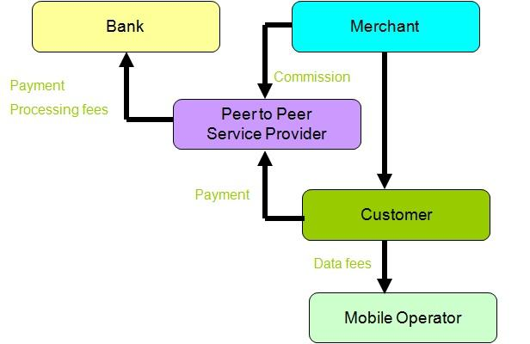
Independent Model
An independent service provider enables mobile payments
Seeks to avoid pre-existing payment systems to processing costs for transactions
May design and distribute an application for an NFC-enabled device
Sources: http://kunalroychoudhury.blogspot.ca/2012/08/mobile-payment-models-stake-holders.html and http://www.smartcardalliance.org/resources/lib/Mobile_Payment_Business_Model_Research_Report.pdf

Slide 11
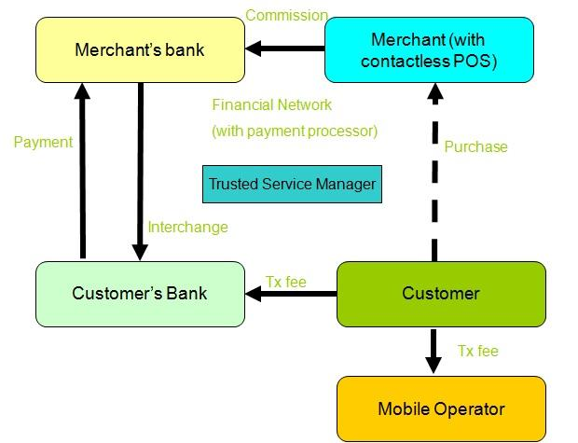
Collaborative Model
Requires the co-operation of both MNOs, banks and possibly a third party to manage the mobile application itself
Revenue generated by:
splitting the revenue generated through merchant fees
Sources: http://kunalroychoudhury.blogspot.ca/2012/08/mobile-payment-models-stake-holders.html and http://www.smartcardalliance.org/resources/lib/Mobile_Payment_Business_Model_Research_Report.pdf

Slide 12

Privacy and Legal Issues
General Security Threats for NFC
Eavesdropping
Data Corruption
Data Modification/Data Insertion
Man-in-the-Middle Attacks

Slide 13
Privacy and Legal Issues (cont.)
Financial Consumer Protection
Disclosure and Transparency
Protection of Consumer Privacy
Protection of Consumer Data
Protection Against Fraud

Slide 14
Applications and Solutions: Alipay Wallet
Model
The Peer-to-Peer/Independent Model
Changing and transform traditional methods
Transactions done mobily
Introduction of official accounts implies they are not collaborating with banks and MNOs
Internet connections
Problem
Offline payments
Soundwave technology

Slide 15
Applications and Solutions: Alipay Wallet (cont.)
Mobile phone and Internet Access
Scan barcode
Camera smartphone
Scanning barcode (gun attached to cash register)
Security
Multiple names and passwords
Biometric-Identification feature
Future: Facial Recognition

Slide 16
Applications and Solutions: Apple Pay
Model
The Collaborative Model
Partners with American banks
Debit/Credit card
New iPhone’s containing NFC (near-field communication) chip

Slide 17
Applications and Solutions: Apple Pay (cont.)
Technology
NFC (near-field communication)
Enables wireless transmission of data from one device to another in a short range of distance
Security
Touch ID and skin contact
Device Account Number
Tokenization
Cryptograms
Dynamic security code

Slide 18
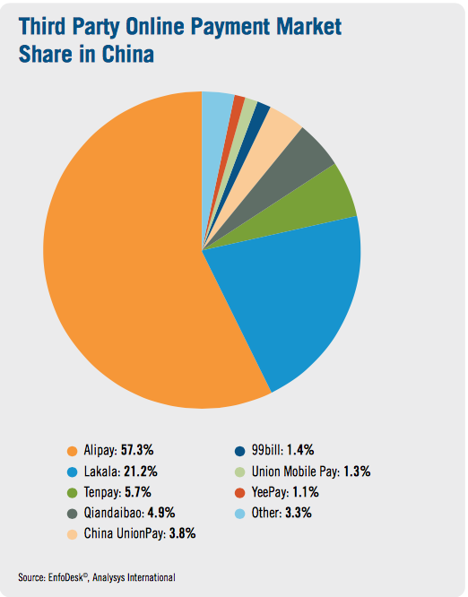
Alipay Wallet
Alipay Wallet is the mobile application version of Alipay (Third-party online payment platform with no transaction fees), which allows consumer to purchase goods and services in shops using their smartphone (Available for Android, iPhone, and Windows phones)
Alipay:
300 Million users
Total transaction in 2013: $12.5 Billion
Alipay Wallet:
The largest mobile payment platform in the world
190 Million active users
Total Volume of mobile transaction: $150 Billion
Total mobile transaction in 2013: $2.8 Billion

Slide 19
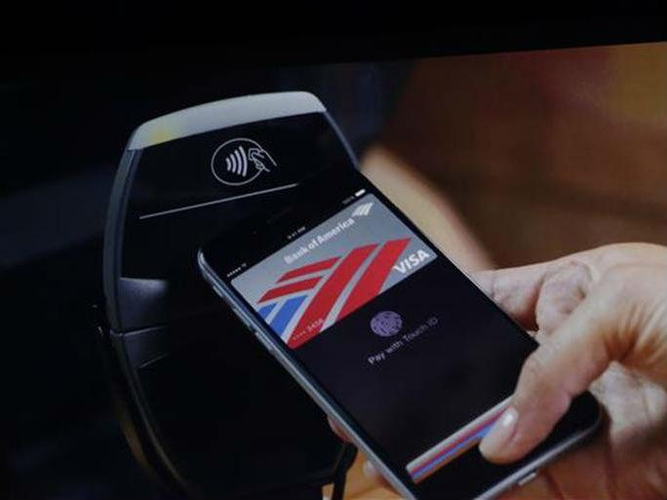
Apple Pay
Apple Pay is a mobile payment and digital wallet service by Apple Inc. Apple Pay lets users make payments using the Apple devices. Users can use their iPhone, Apple Watch, or iPad to pay in a simple secure, and private way.
One touch to pay with Touch ID
Pay with a single touch within apps
Add the credit or debit card to Passbook

Slide 20
Advantages of Alipay Wallet
Allow customers to make transactions via mobile application,even on non-NFC enabled phone.
Alipay creates a unique, disposable barcode.
Two way payments are accepted by retailer.
Alipay has enabled payments to be made offline via sound wave technology.
Mobile terminal service includes all advantages of cross-border website payment.

Slide 21
Disadvantages of Alipay Wallet
Customers need to spend time to set-up and make the verification through their email and mobile phone. Moreover, customers need the verify their bank account and their debit/credit card in order to link up with their Alipay account.

Slide 22
Advantages of Apple Pay
More convenient
Customers can pay in store without their debit/credit card.
More secure
customers can provide their own touch ID which is unique and cannot be duplicated. In addition, Apple could protect customer’s accounts even if customers lose their device.
Keep purchases private
Apple pay doesn’t store the details of customers transactions. Also, customers do not need to show their debit/credit card.

Slide 23
Disadvantages of Apple Pay
Only works using NFC technology on an Apple device. Apple Pay is only compatible with iPhone 6 and iPhone 6 plus.
Must be work under network environment.
Not popularize to all stores.

Slide 24
Conclusion
Many businesses are offering mobile payment and must adjust their business models accordingly
Ali Pay Wallet and Apple Pay are examples of how they are succeeding
Time will tell: changing payment forever or just hype?

